Slide 1
BILG08024
Biology 2A: Data Exploration in Biology

Slide 2

Why do you have to do this course?

Slide 3
What will this course teach you?
Data management and exploration using pandas and seaborn
You will learn how to:
enter, clean, and re-arrange data,
merge and split datasets,
produce basic summary statistics,
use a variety of plots to explore the data,
define groups and test relationships between them,
use clustering to look for patterns in large datasets,
reduce dimensions in large datasets using PCA.

Slide 4

Why is this important?

Slide 5
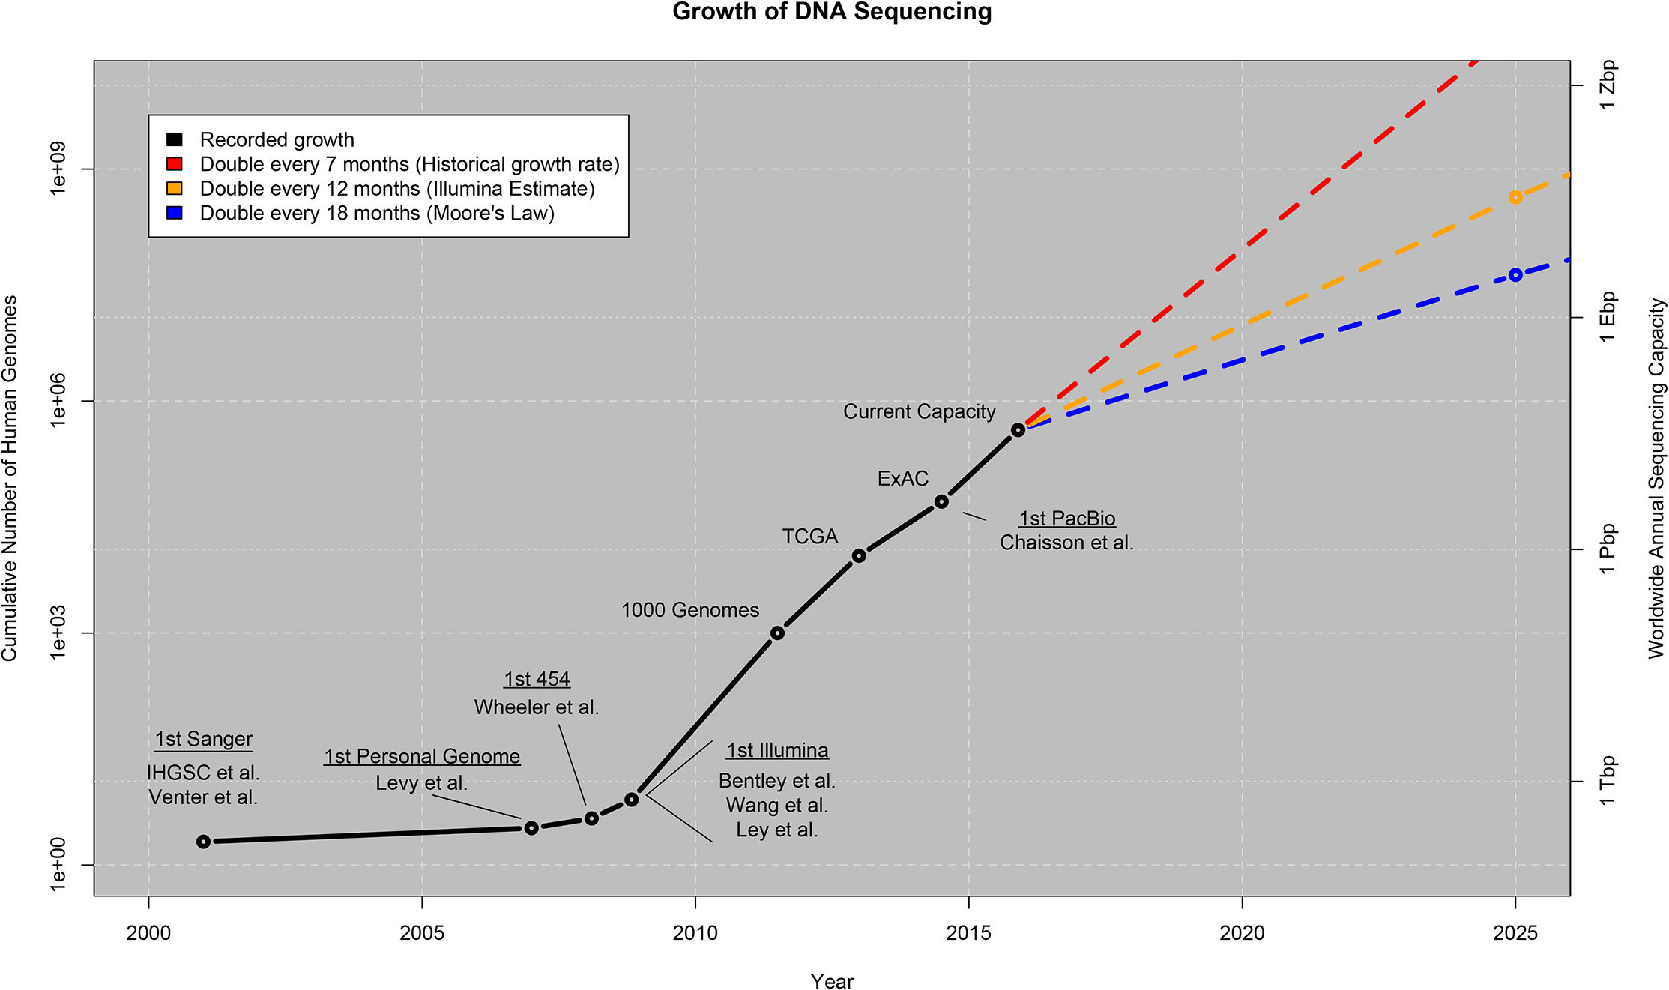
https://doi.org/10.1371/journal.pbio.1002195

Slide 6
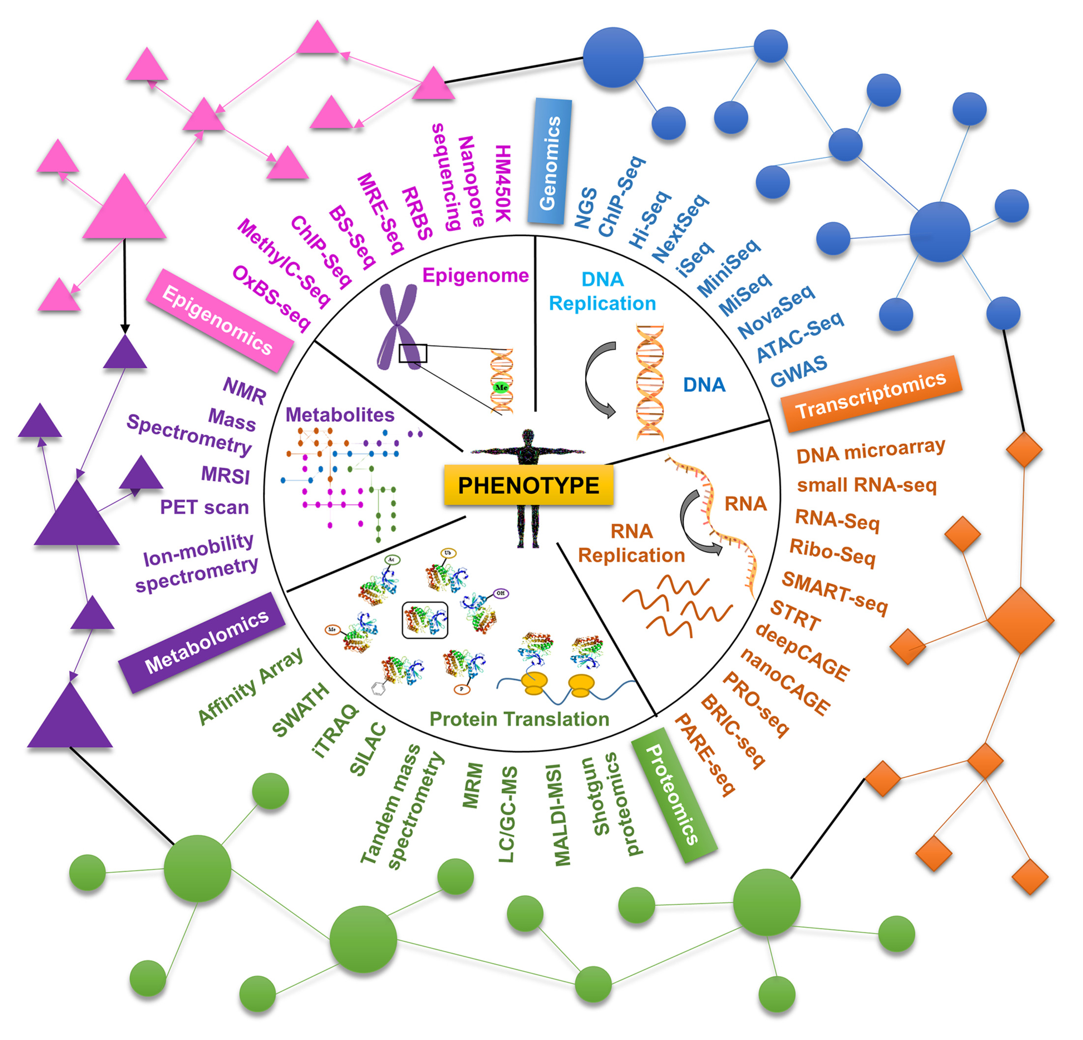
https://doi.org/10.1016/bs.apcsb.2021.03.006

Slide 7
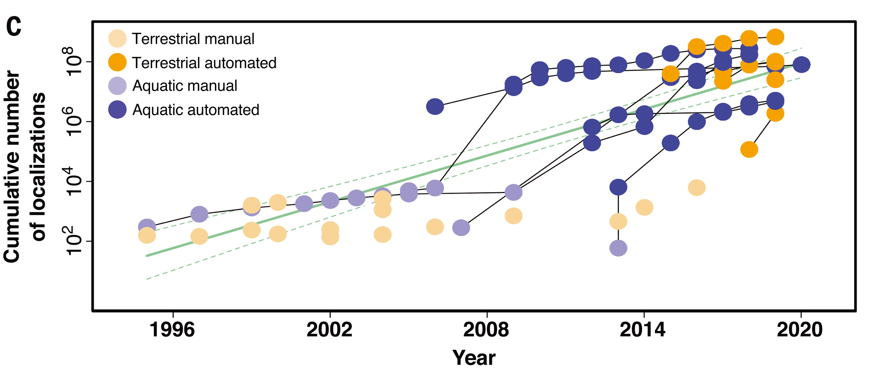
DOI: 10.1126/science.abg1780

Slide 8
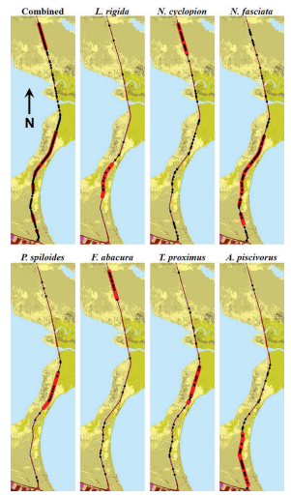
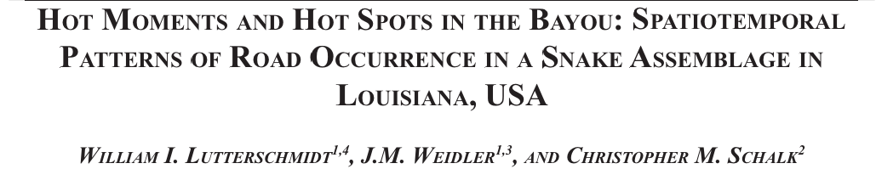
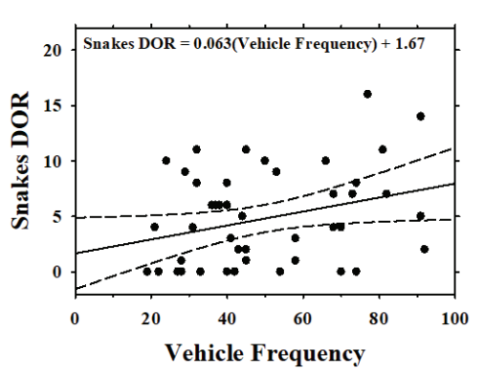
Herpetological Conservation and Biology 14(2):533–545.

Slide 9
How will we teach you?
We will provide short introductory lectures and walk you through coding to illustrate the topics or each week,
Much of the work will be done in groups working through notebooks online.
The first class of each week will guide you through learning new techniques and the second class will give you more scope to explore how these techniques are used with real data to address biological questions. Once you have a good grip of the techniques, you will choose a dataset and work as a group to explore it, producing a poster to describe your results.

Slide 10
How will you be assessed?
There will be weekly short online quizzes for you to check you are keeping up.
You will use your portfolio to describe your approach to your group data analysis project.
A time-limited analysis exercise will give you scope to show what you can do.
The final poster will be assessed by students and staff.

Slide 11
What is expected from you
You should review the lecture ppt and notebooks before class.
You need to make best use of class to learn from the demonstrators.
You need to manage your time in the group data analysis and work together to apply what you have learnt.

Slide 12

Getting help
Cheat sheet check
Ask the person next to you
Ask a demonstrator
Look online
Ask Course Staff

Slide 13
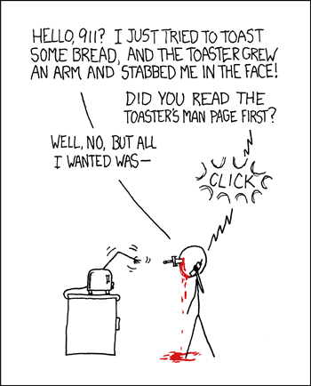
How to search for help 1.
Read the docs
https://pandas.pydata.org/docs/user_guide/10min.html
This is a short introduction to pandas, geared mainly for new users.
https://pandas.pydata.org/docs/user_guide/cookbook.html#cookbook
This is a repository for short and sweet examples and links for useful pandas recipes
Seaborn site

Slide 14
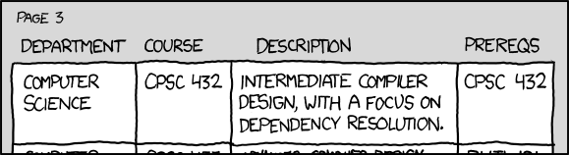
How to search for help 2.
Online courses
https://datacarpentry.org/python-ecology-lesson/
https://swcarpentry.github.io/python-novice-inflammation/

Slide 15
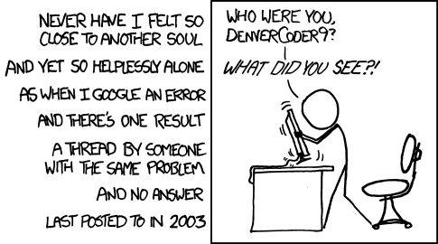

A good search strategy
Google the error message
(often surprisingly unhelpful with pandas)
Use the correct terms (the document pages are helpful here)
“make a change in part of a table depending on the rest”
“pandas new value conditional”
a common hit and can be useful
Can be misleading
Answers can be very old – refering to Python2.6
Can be wrong

Slide 16
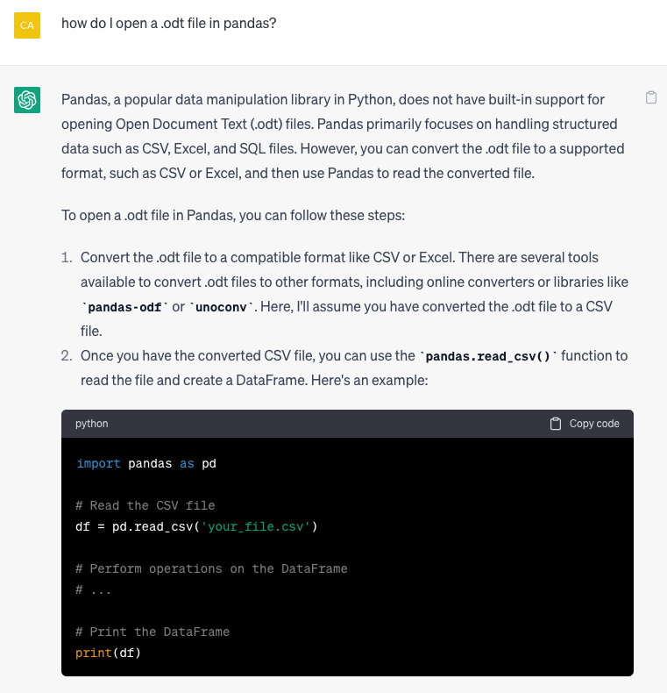
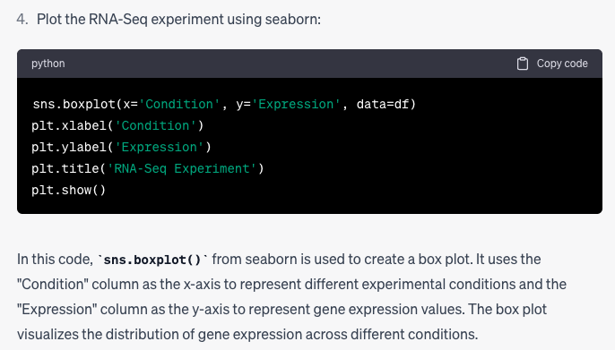
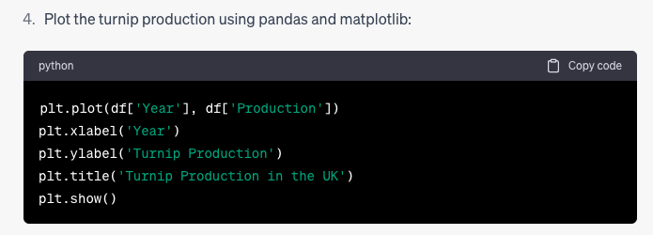
Chat GPT
Can be a good starting point. Be critical!

Slide 17
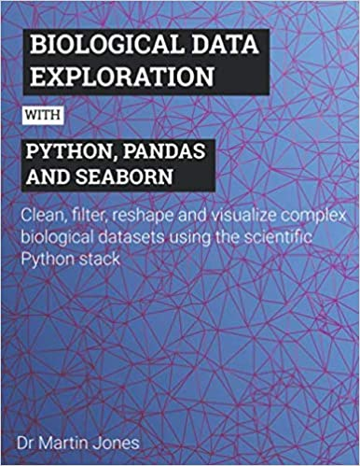
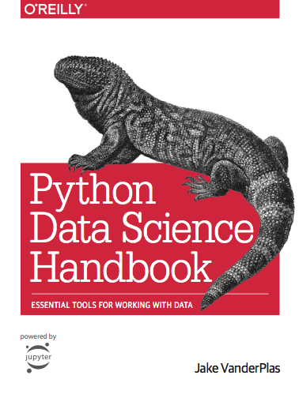
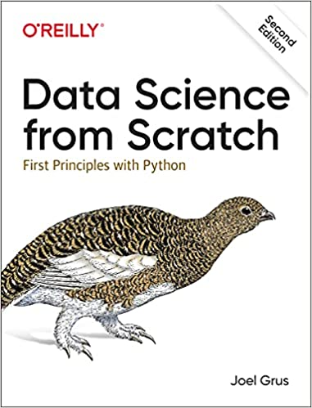
If you like a book to hand…
Assumes no python
(but some maths)
Modeling focus
Not free
For biologists
Assumes basic python
Clear examples
Not free
Programming focussed
https://jakevdp.github.io/PythonDataScienceHandbook/

Slide 18
